Slide 1



Tuesday, January 15, 2013
Agenda:
TISK & 2 MM
Lesson 7-4: Parallel Lines & Proportional Parts
Homework: Start §7-4 problems in Ch 7 Packet 2
TISK Problems
Factor completely: $14x^{2}−69x+27$
Calculate the value of x:
Classify the special quadrilateral shown. Provide a theorem, postulate, or definition that supports your answer.
$$x$$
$$3x−12$$
Notes:
Mental Math
1.) Start with 4 times the sum of 8 and 6. Divide the difference of that number and 4 by 13. Square your result. Subtract the square of 3. (7)
2.) Start with three less than the quotient of 58 and 2. Double it. Find the difference of that number and 13. Divide by 3. Subtract the product of 2 and 3. (7)

Slide 2

§7.4 Parallel Lines & Proportional Parts
Ex. 3
Ex 4
Ex 5
Theorem: Triangle Proportionality Theorem
If a line parallel to one side of a triangle intersects the other two sides, then it divides the two sides proportionally.
B
$$\frac{EC}{BE}=\frac{AD}{BD}$$
D
E
A
C

Slide 3

Example
In the diagram $\overline{AB}∥\overline{ED}$, BD = 8, DC = 4, and AE= 12. What is the length of $\overline{EC}$?
C
Using the Triangle Proportionality Theorem, we have:
4
D
E
8
12
B
A

Slide 4

Theorem: Converse of the Triangle Proportionality Theorem
If a line divides two sides of a triangle proportionally, then that line is parallel to the third side.
B
B
D
E
$$\frac{EC}{BE}=\frac{AD}{BD}$$
E
D
A
C
A
C

Slide 5

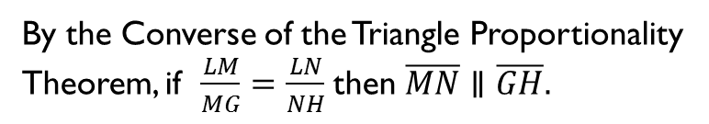
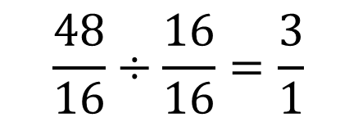
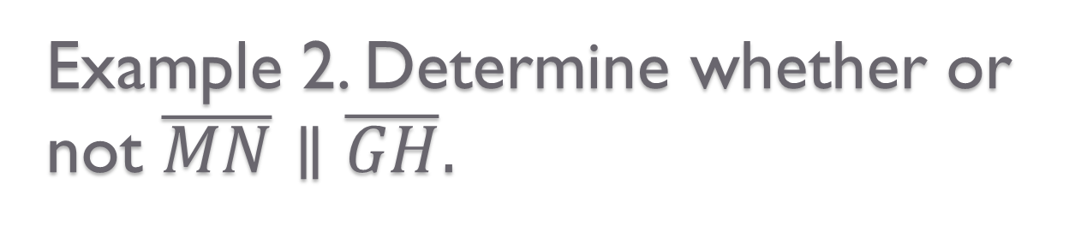
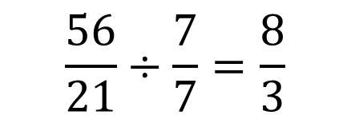
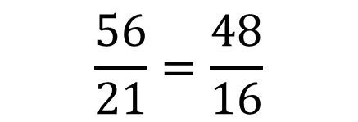

Example 2. Determine whether or not $\overline{MN}∥\overline{GH}.$
G
By the Converse of the Triangle Proportionality Theorem, if $\frac{LM}{MG}=\frac{LN}{NH}$ then $\overline{MN}∥\overline{GH}.$
21
M
56
$$\frac{56}{21}=\frac{48}{16}$$
?
L
48
N
16
H
$$\frac{56}{21}÷\frac{7}{7}=\frac{8}{3}$$
$$\frac{48}{16}÷\frac{16}{16}=\frac{3}{1}$$
$$\frac{8}{3}≠\frac{3}{1}$$
$$∴\overline{MN}∦\overline{GH}$$

Slide 6
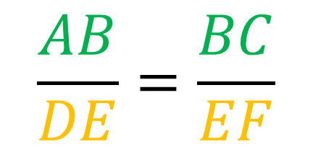
Theorem.
Ex. 3
Ex 4
Ex 5
If three parallel lines intersect two transversals, then they divide the transversals proportionally.
C
$$\frac{AB}{DE}=\frac{BC}{EF}$$
B
A
D
E
F

Slide 7
Theorem
Ex. 3
Ex 4
Ex 5
If a ray bisects an angle of a triangle, then it divides the opposite side into segments whose lengths are proportional to the lengths of the other two sides.
A
AD
=
BD
D
AC
BC
C
B

Slide 8




Example 3
Triangle Proportionality Theorem
3 Parallel Lines Intersecting 2 Transversals
A Ray Bisecting an Angle of a Triangle
In the diagram, $∠1≅∠2≅∠3, AB=6,$ $BC=9, EF=8.$ What is x?
$$\frac{6}{x}=\frac{9}{8}$$
C
3
9
B
2
$$48$$
$$9x$$
6
A
1
x
8
F
D
E

Slide 9
Example 4
Triangle Proportionality Theorem
3 Parallel Lines Intersecting 2 Transversals
A Ray Bisecting an Angle of a Triangle
Find the value of the variable.
14
8
x
20

Slide 10

Example 5
Triangle Proportionality Theorem
3 Parallel Lines Intersecting 2 Transversals
A Ray Bisecting an Angle of a Triangle
In the diagram, $\overline{FJ}∥\overline{GI}$. Find the values of the variables.
F
G
2
8
H
9
y
x
12
I
J

